Slide 1
JNCIS-ENT
Border Gateway Protocol (BGP)

Slide 2
BGP Overview
1
The routing protocol of the internet

Slide 3
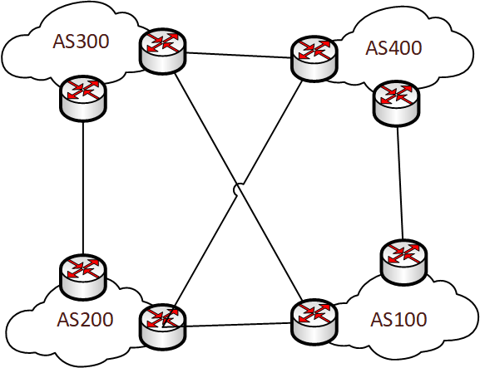
What is BGP?
BGP is the routing protocol of the internet
BGP is commonly used as an Exterior Gateway Protocol
It can also be used an an IGP
Commonly called a Path Vector dynamic routing protocol
Due to the AS Path used as the loop prevention mechanism
Highly scalable and capable of exchanging millions of routes
BGP speaking routers exchange Network Layer Reachability Information (NLRIs)
When used as an EGP, exchanges routes between ASs
An AS is a network under a single administrative domain
Defined in RFC 4271
Supersedes RFC 1771
BGP uses TCP as the transport protocol to establish connectivity
TCP port 179

Slide 4
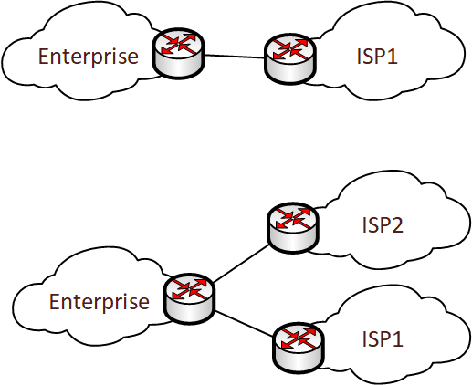
Why Use BGP?
BGP is typically used in an enterprise when multi-homed to multiple ISPs
When single homed, or multi-homed to a single ISP, an enterprise will typically use static default routes with a next-hop of the ISP
When using a single ISP, typically a non-portable subnet is used
A non-portable add subnet is one owned by the ISP and cannot be used by the enterprise with another ISP unless a Letter of Authorization (LoA) is obtained
A portable subnet is one that the enterprise has registered and purchased, it may be advertised by the enterprise to any ISP
BGP can provide maximum policy-based flexibility to influence egress and ingress traffic flows for a particular autonomous system

Slide 5
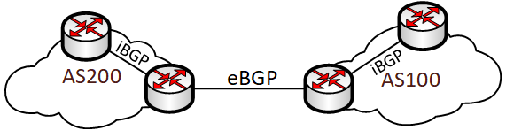
eBGP vs. iBGP
eBGP is external BGP and represents BGP peering between autonomous systems
eBGP is most common in the enterprise
iBGP is an internal BGP peering, between routers within the same autonomous system
iBGP is found within enterprise networks sometimes, though not as common
eBGP peering messages have a TTL of 1 by default
This expects the peers to be directly connected. If they are not directly connected, then multi-hop must be configured to allow the peerings to establish
eBGP peerings are typically established using interface IPs, whereas iBGP peerings are typically established using loopback interface IPs

Slide 6
BGP Loop Avoidance
BGP NLRIs include a list of ASs that the path to the destination passes through
If the AS of the of the receiving router appears in the AS path, the route is dropped
This prevents routing loops in BGP
iBGP peers will not advertise routes learned from one iBGP peer to another iBGP peer
The mechanism is called BGP Split Horizon
Creates a full-mesh peering requirement if other scaling mechanisms are not used

Slide 7
BGP Peering
Unlike other IGPs, BGP does not have a dynamic neighbor discovery mechanism
Neighbors must be manually configured
BGP operates over TCP port 179
TCP is used as the transport protocol to ensure reliable delivery of BGP packets
Since iBGP peers are typically configured between loopback interface addresses, an IGP is required to provide loopback connectivity

